Slide 1
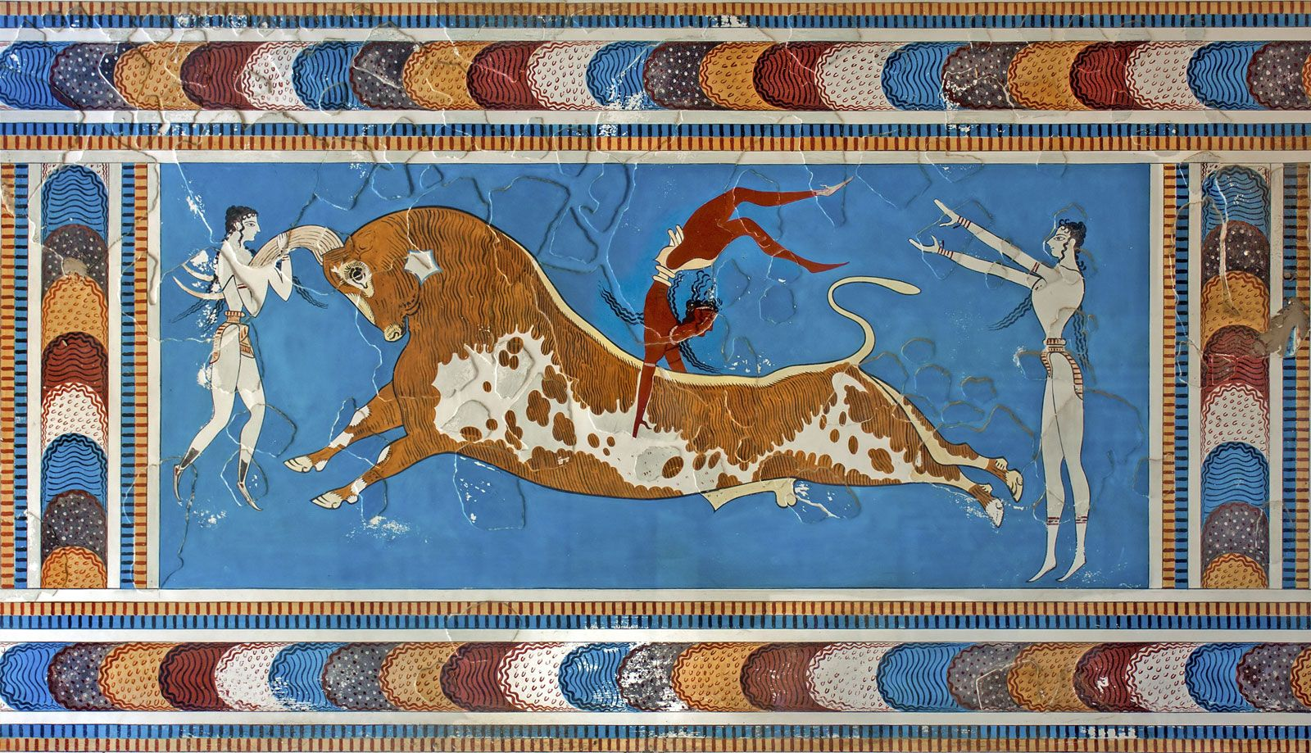
Minoans – Economic/Military Structures
Goal/s:
Identify and describe the key features of the Minoan economic and military structures
Week 3 Lesson 3
Ms Barrie

Slide 2
Today’s Lesson
Economic and military structures of minoan society

Slide 3

Economic Structure
KEY TERM
DEFINITION:
a system of production, resource allocation and distribution of goods and services within a society or a given geographic area
What economic structures do you already know of?

Slide 4

The Minoans became one of the most powerful forces in the Aegean, expanding their cultural ideas across the Mediterranean and creating the first foundations of a unified Western culture. However, their power wasn't simply militaristic; it was economic. Through trade and exchange, the Minoans managed to secure lots of power and left quite a legacy.

Slide 5
Crete
Write the dot-points
The largest of the Greek islands
Fertile soils
Moderate temperatures & reliable rainfall.
A great place for agriculture.
Not only did the ability to grow lots of food result in the conditions necessary for the Minoans to develop the first advanced civilization of Europe, but it also gave them the tools they needed to build a strong international economy.

Slide 6
Crete
Write the dot-points
Maritime trade of agricultural products (wine, olives, and figs)
Exchange for minerals and other resources (copper and ivory
Built:
quality roads that connected farms/exchange centres to ports
maintained a massive and impressive fleet of ships.
Evidence of Minoan products and cultural influences have been found in mainland Greece, Asia Minor, the entire Mediterranean coast of the Middle East, and even as far as Egypt. Products and artistic ideas from each of these cultures have also been found in Minoan Crete, so we can tell that there was a high degree of exchange between these groups.

Slide 7
2 key ideas
Write the underlined terms
Maritime empire.
According to later mainland Greek sources, the Minoan kings developed an extensive maritime empire that stretched across the Aegean and eastern Mediterranean Sea. This would have given the Minoans something of a trade monopoly in this region, controlling ports and the exchange rates of various products. Allegedly, their navy was feared by all, and their merchants were found in every port of the region.
The Minoans also intentionally transported their arts and cultural ideas into regions where they held ports, helping to make other cultures friendlier to them.

Slide 8
2 key ideas
Write the underlined terms
Palace economy
The other definitive trait of the Minoan economy is how they managed their economies at home. The traditional view is that the Minoans were one of the first civilisations to develop a palace economy in which royal administrative centres were used to gather up and then redistribute all the products and services needed in Crete. Basically, instead of developing a monetary system where goods could be exchanged based on set values, the Minoans sent all their goods to these palaces, who then split them up and redistributed them among the people.

Slide 9
Watch the following video – Brain break
https://www.youtube.com/watch?v=6bDrYTXQLu8&ab_channel=NationalGeographic

Slide 10
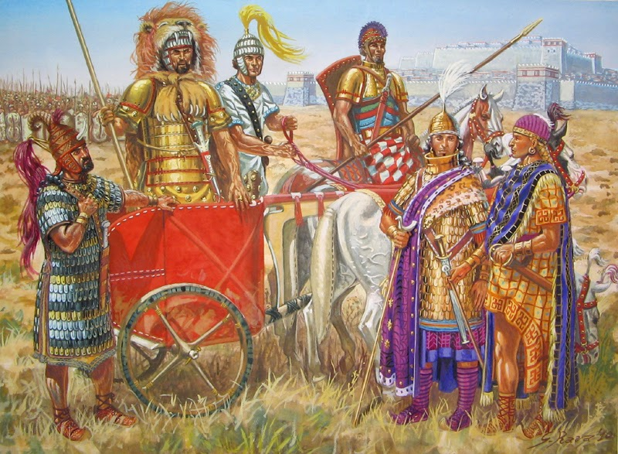
Military Structure
KEY TERM
DEFINITION:
structuring of the armed forces of a state to offer such military capability as a national defence policy may require.
What military structures do you already know of?

Slide 11
The complexities of ruling a bronze age city included accidental fires, riots, coups, raids, and the threat of foreign invasion and sacking. Minoan Crete's political history was just as complicated and violent as any other bronze age civilizations. Large spectator sports such as bull leaping, wrestling, and boxing, were used as societal stress relievers.

Slide 12
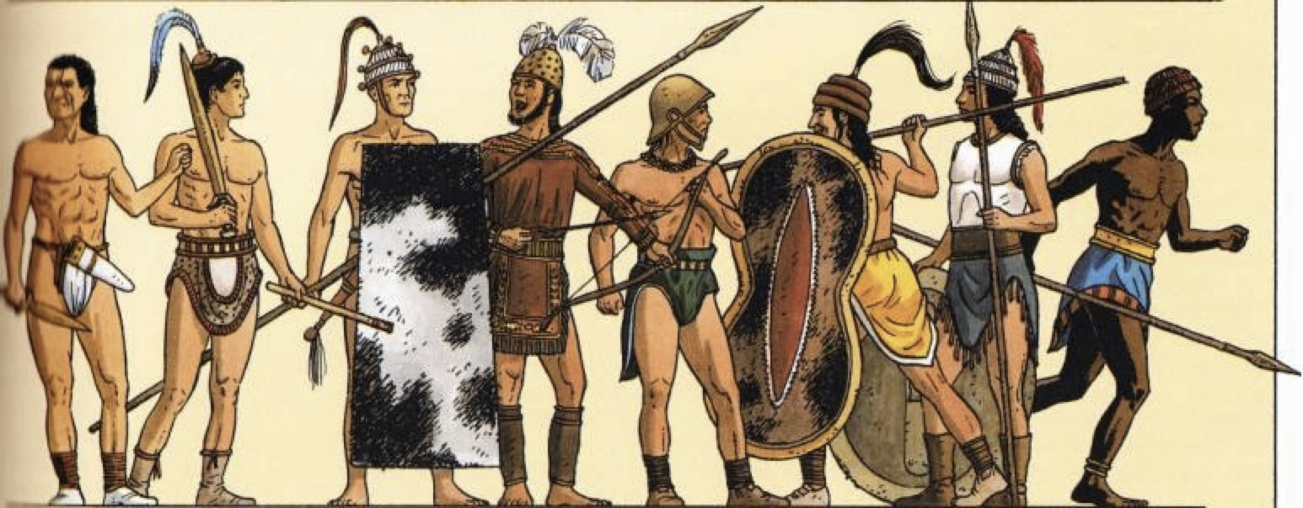
Source 1 What can you tell about the Minoan military?
Notes:
In the small amount of frescoes we do have, soldiers are shown wearing tunics reinforced with bronze, and bronze helmets made from up to eight parts.
Since body armor was the most prohibitively expensive object, many warriors are seen with large shields and well made helmets, opting to focus on the best protection they could afford.
Warriors are shown without body armor at times, more in line with normal Minoan male fashion
The nobility could afford the best armor, which was entirely made of bronze.

Slide 13
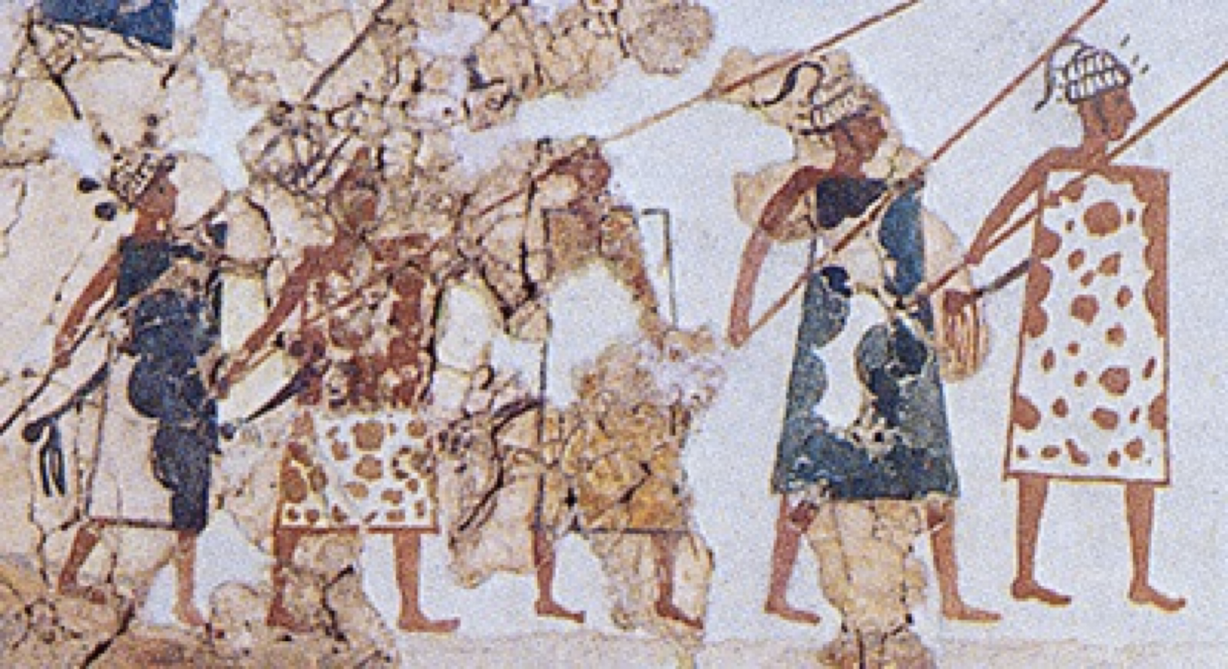
Source 2 What can you tell about the Minoan military?
Notes:
Minoan fresco from Akrotiri, dated to around 1,600 BCE, showing soldiers with spears, boar tusk helmets, and cowhide rectangular shields

Slide 14
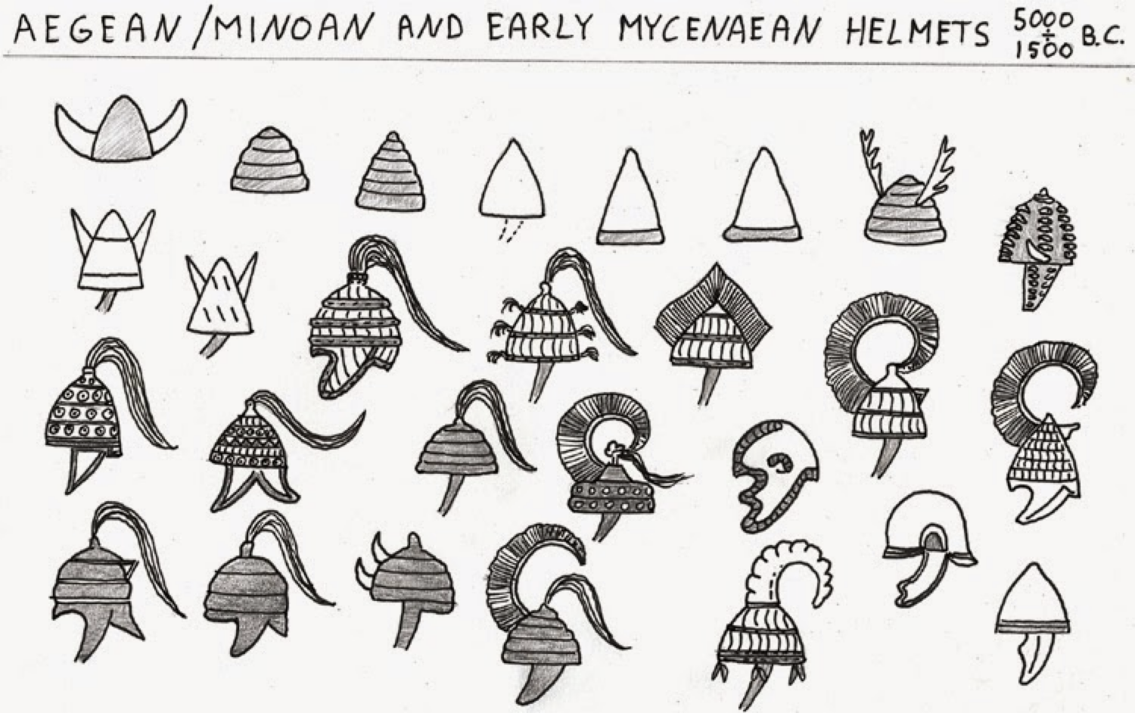
Source 3 What can you tell about the Minoan military?
Notes:
Most Minoans could not afford the expensive crested bronze helmets or boar tusk helmets of the nobility. Most people wore leather, linen, or even felt helmets. These were reinforced by small disks of bronze, for those who could afford them.

Slide 15
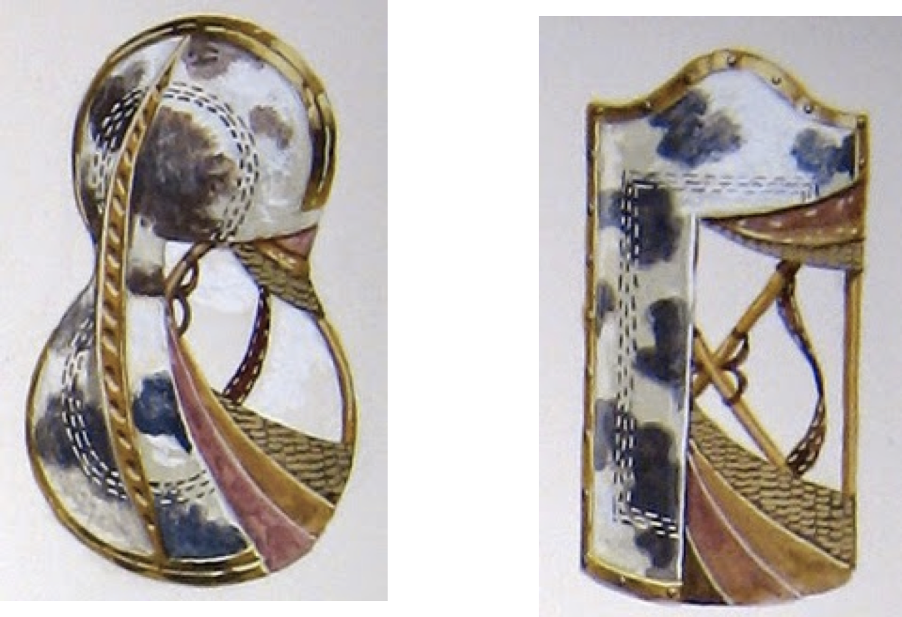
Source 4 What can you tell about the Minoan military?
Notes:
Used many types of shields, ranging from small to large
Most recognizable is the figure eight shield (seen in both the Minoan and Mycenaean cultures)
Also used rectangular tower shields, as well as some which had curved tops.
Shields were made out of a wooden frame, covered in cowhide.
Gold trimmings or other decorations were added to the edge of the shield by master craftsmen.
The most expensive shields were the most effective, as only the wealthiest could afford an entirely bronze tower shield.
Many people would have used smaller circular or square shields, and such shields are shown in frescoes having decorative fringes.

Slide 16
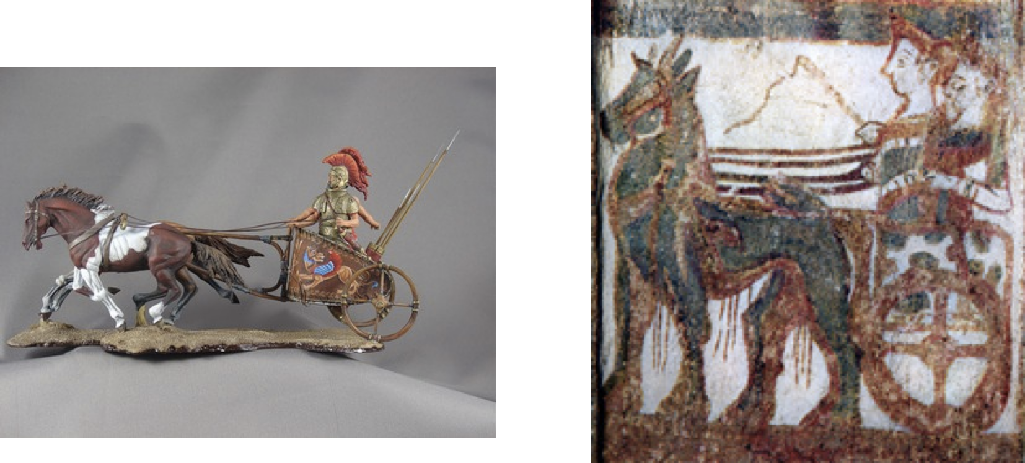
Source 5 What can you tell about the Minoan military?
Notes:
Used in battle - large significance

Slide 17
Minoan Military
Main defense, from at least external enemies, were their naval fleets
Small isolated stone buildings found across the coastline around Pylos were most likely coast guards, a ring of watchtowers
Temple Palaces - strong defensive positions with weaponry
Used both long and short spears for close combat and javelins.
To fight not only other humans, but lions and animals as well.
Generally throughout the bronze age, swords were much harder to make and to maintain than spears
For this reason, spears were the most common weapon on the ancient battlefield.

Slide 18

SUMMARY
IDENTIFY 5 different words that best describe the Minoan economy.
IDENTIFY 5 different words that best describe the Minoan military.
When complete, check with Ms Barrie.
EXTENSION ACTIVITY – Create your own shield.

